Slide 1
Spread of Disease
Sharing Bad News
Meisam Amjad, Songmi Koo, Tien Anh Nguyen, Yunquin Zhao,
Md Rashef Mahbub, Urvashi Desai

Slide 2
Overview
Background
SIR Model
SIR Model and the Hong Kong Flu (Deterministic)
Stochastic SIR Model
Anylogic Simulation: i) Random based ii) Distance based
Future work

Slide 3
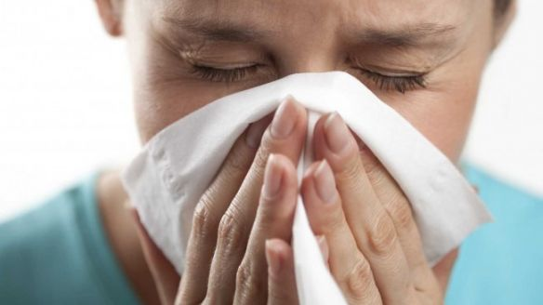
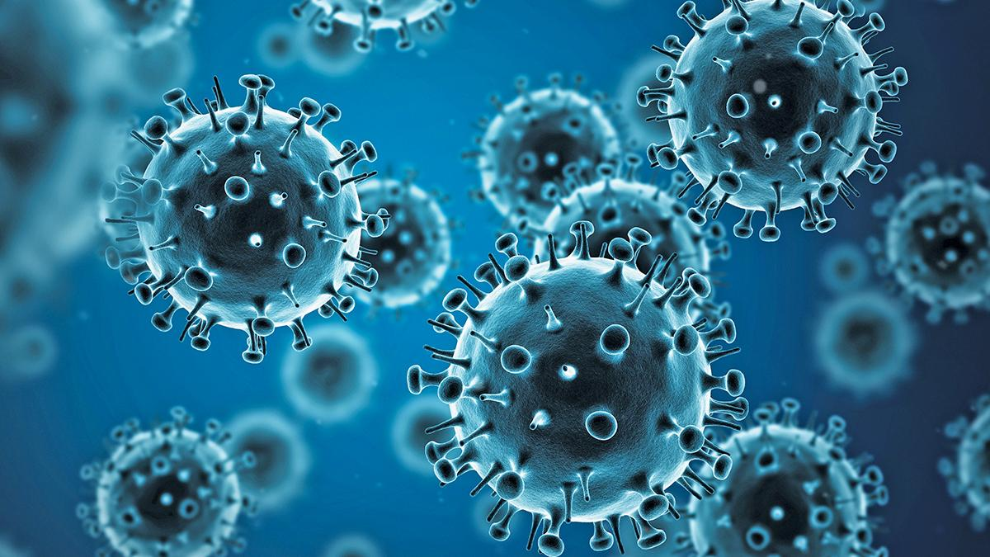

Influenza
Influenza (flu) is a contagious respiratory illness caused by influenza viruses that infect the nose, throat, and sometimes the lungs.
Notes:
The flu is a contagious respiratory illness caused by influenza viruses that infect the nose, throat, and sometimes the lungs. It can cause mild to severe illness, and at times can lead to death. The best way to prevent the flu is by getting a flu vaccine each year.

Slide 4
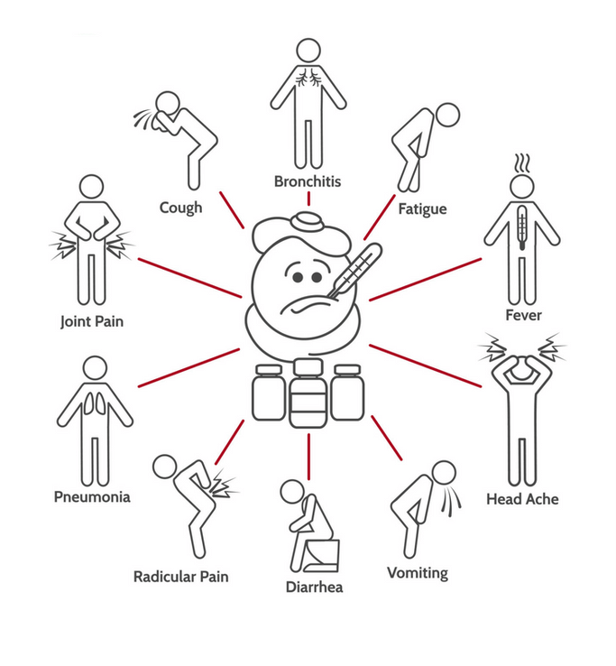
Influenza
Notes:
Signs and symptoms include , …
HOW FLU SPREADS ? Most experts believe that flu viruses spread mainly by tiny droplets made when people with flu cough, sneeze or talk. These droplets can land in the mouths or noses of people who are nearby. Less often, a person might also get flu by touching a surface or object that has flu virus on it and then touching their own mouth, nose, or possibly their eyes.

Slide 5
SIR Model
Susceptibles (S) have no immunity from the disease
Infected (I) have the disease and can spread it to others
Recovereds (R) have recovered from the disease and are immune to further infection. Those who died are also included in recovereds.
The model gives the differential equation for the rate of change for each of these populations
Notes:
What is SIR Model ?
S- number of susc individuals
I- no of infected indivisuals
R- no of recovered/removed individuals.

Slide 6
Changes in s, i, r
s_{t+1} = s_{t} - 𝛂s_{t}i_{t}
i_{t+1} = i_{t} + 𝛂s_{t}i_{t} - 𝛄i_{t}
r_{t+1} = r_{t} + 𝛄i_{t}
Notes:
Changes in s : Its assumed that the disease is spread once a susceptible individual comes in contact with an infected individual and becomes infected, however only a proportion alpha of the encounters between suscps and infcs are regarded as infected. So, when considering the next time interval, an equation can be derived as ^
after one time interval the infective class grows by the addition of the newly infected. During the interval some infectives recover or pass away and are progressed to the removed stage of the disease.

Slide 7

Assumptions
Homogenous Mixing
Constant Population Size
No contagious period
Notes:
Homogenous mixing - the first is that the model considers homogenous mixing in which each pair of individuals has equal probablity of coming into contract with one another. In other words any uninfected individuals face the same risk of being exposed to the disease through those who have already been infected.
Constant Population Size - the second assumption is that the population size N is large and constant without any net birth/ death/ immigration or emigration. Within this assumption, the only way for an individual to leave S is to come into contact with a member of I and become a member of I
No latency - means that one gets immediately infectious once infected.
You may be able to pass on the flu to someone else before you know you are sick, as well as while you are sick. Although people with the flu are most contagious in the first 3-4 days after their illness begins, some otherwise healthy adults may be able to infect others beginning 1 day beforesymptoms develop and up to 5 to 7 days after becoming sick. Some people, especially young children and people with weakened immune systems, might be able to infect others with flu viruses for an even longer time.
So, in order to formulate the SIR model, susceptibles remain disease free or become infected, infectives pass through an infectious perios until they are recovered permanentaly and a recovered individual is never at risk again.

Slide 8
Deterministic SIR Model

Slide 9

SIR Model and the Hong Kong Flu
33,800 deaths
In the U.S.
500,000 deaths
In Hong Kong
1968-1969
1 million deaths worldwide
Notes:
One famous epidemic in which the SIR model was applied was the Hong Kong Flu. During 1968 to 1969 an influenza pandemic known as the Hong Kong Flu killed an estimate of one million people worlswide.
The epidemix was caused by an H3N2 strain of the influenza A virus with origins in the H2N2 antigenic shift, a genetic process in whch genes from multiple subtypes reasserted to form a new virus.
Within several months it had reached the Panama Canal Zone and the United States, where it had been taken overseas by soldiers returning to California from Vietnam.

Slide 10
Variables used
Total population | N | 7,900,000
Susceptibles | S₀ | 7,900,000
Infected | I₀ | 10
Recovered | R₀ | 0
Infection rate | 𝛂 | 1/2
Recovery rate | 𝛄 | 1/3
Susceptible fraction | s(0) | 1
Infected fraction | i(0) | 1.27 x 10⁻⁶
Recovered fraction | r(0) | 0
Notes:
In order to understand how the SIR model was applied in real life epidemics we considered the population of NYC in 1960s. Hardly anyone in NYC was immune to this virus, thus making everyone susceptible.(7
Let us assume that 10 people were infected initially.
And since its the initial condition, nobody was neither recovered nor removed.
Diving the values by N (total population), we will get s,i,r as :
The infection rate is assumed as ½, which means one new person gets infected every other day
The estimated average period of infection was taken as 3 days, giving us the recovery rate or gama = ⅓

Slide 11
SIR Model and the Hong Kong Flu
𝝙s = - ½ s_{t}i_{t}
𝝙i = ½ s_{t}i_{t} - ⅓ i_{t}
𝝙r = ⅓ i_{t}

Slide 12
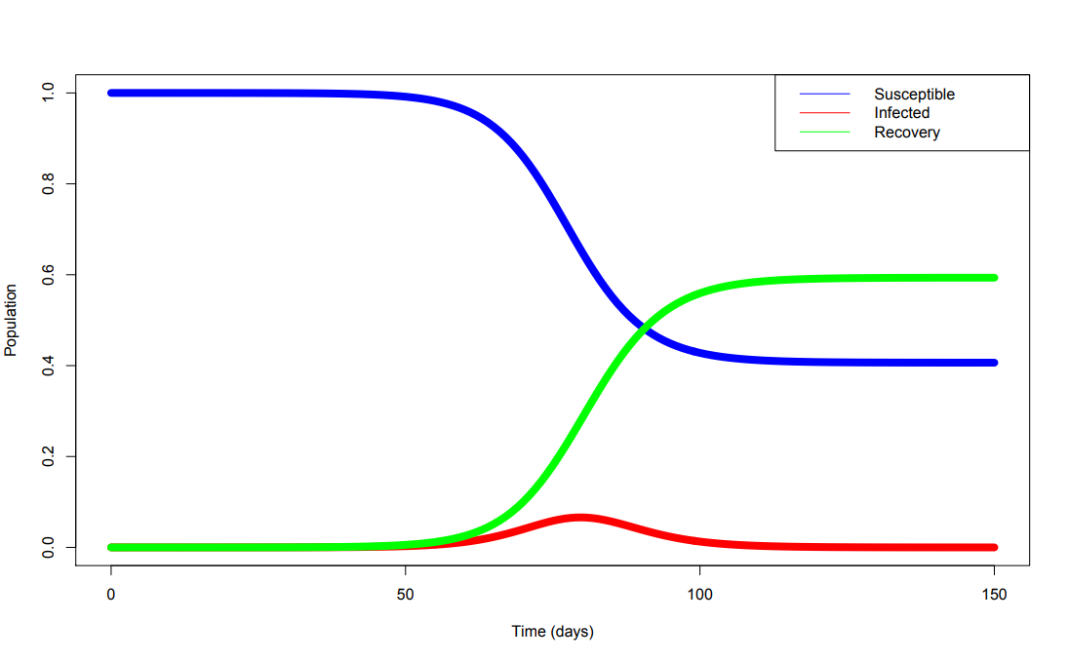
𝝙time = 1
Notes:
As we all know from the Module covered in classThere is a drastic drop in the no of suscps after about 60 days. The initial number of suspcs were 7,900,000 and then it drops over half by the end of 150 days (suscp fraction = 0.5) then st levels out and stays 0.4 throughout 100 to 150.
Rt starts to show an increase starting at day 60 and levels off by day 100 at 0.6 and reaches equilibrium
This shows an inverse relationship between the suscps and recovreds, as the number of rec increases, the sucs decrease.
Interestingly, as the no of rec reaches its max point, the suscsps decrease and reach a plateau.
I(t) doesnt change until day 60, reaches max at 80 and then decreases, approaching 0 between 100 and 150.

Slide 13
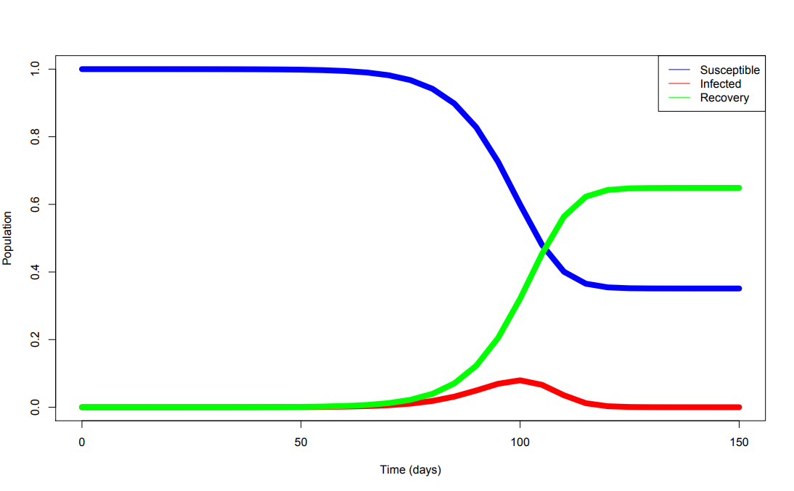
𝝙time = 5
Notes:
Similar to the prev one, st starts to decrease in day 70, levels off in day 110.
Rt exponentially increases on day 70 and then levels off by day 115.
There is no relative change in i(t) till day 70, then it reaches max at day 100 and then decreases by day 115

Slide 14
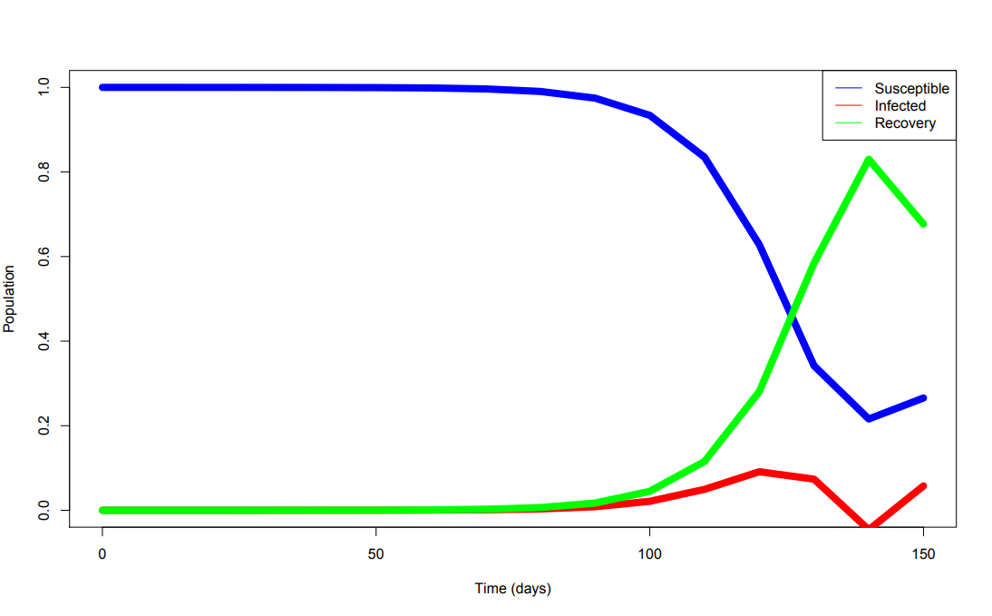
𝝙time = 10
Notes:
The st here starts tp decrease in day 90 and hits its minimum at day 140, but slightly increases by day 150.
Rt starts to model an exponential function and hits its maximum at day 140 but slightly decreases by day 150
i(t) shows no change until day 90 then it increases, hitting a maximum at day 120.
It is interesting to note that the values decrease and actually become negative between 135-140 day. Guess why? This is because we took a large timestep. The extrapolations are being made in greater differences

Slide 15
Deterministic SIR Model - Result
Timestep | Susceptible fraction at equilibrium | Infected fraction at equilibrium | Recovered fraction at equilibrium | Max number of infected pop on day | T at which I=0
1 | 0.6 | 0 | 0.4 | 80 | 100
5 | 0.3 | 0 | 0.7 | 100 | 115
Notes:
Slide for table1

Slide 16
Stochastic SIR Model
Notes:
Infectious individuals have “close contact” with other individuals randomly in time at constant rate, and each such contact is with a randomly selected individual, all contacts of different infectives being defined to be mutually
20% prob of somebody to spread infection
and 20% to catch infection
the line in between is the deterministic one

Slide 17
Variables used
S(0) | 500
I(0) | 10
R(0) | 0
Infection probability | 0.2
Activity rate | 0.2
Recovery rate | 0.02
Notes:
Total number of people in the popul = 500
The inf.prob argument sets the transmission probability per act, and act.rate sets the acts per person per unit time OR the random action rate

Slide 18
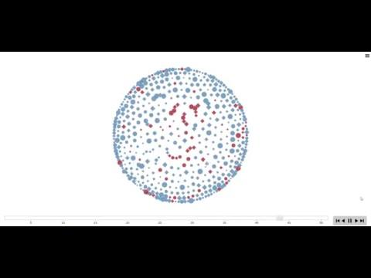
Interactions among the population
Notes:
how in one environment, 500 diff people (diff ages and diff races - cirles are one race and squares are another - their sizes tell the age )can make connections and get infected from each other. --- video-- SI Model - used to just show the random movement

Slide 19
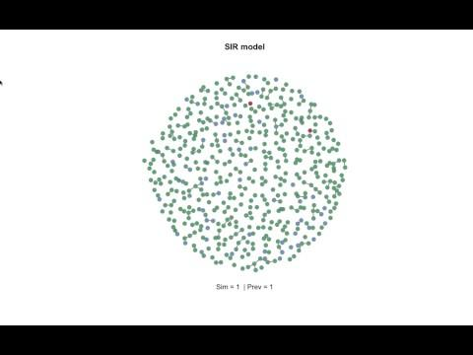
Spread of disease
Notes:
towards the end most of them are recoverred, but there are still some people that are susecptible. and just like 1 infected. these guys make the susc people infected. And still in the end we have some suscpetible that do not catch the infection(only 20% prob).

Slide 20
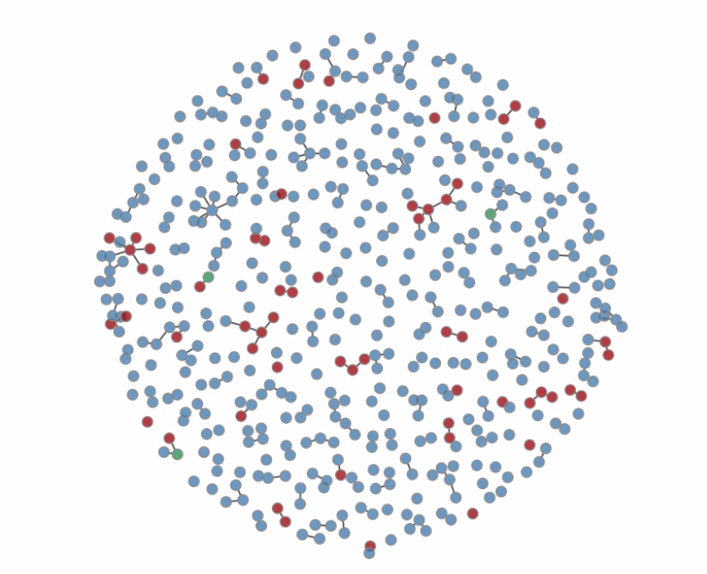
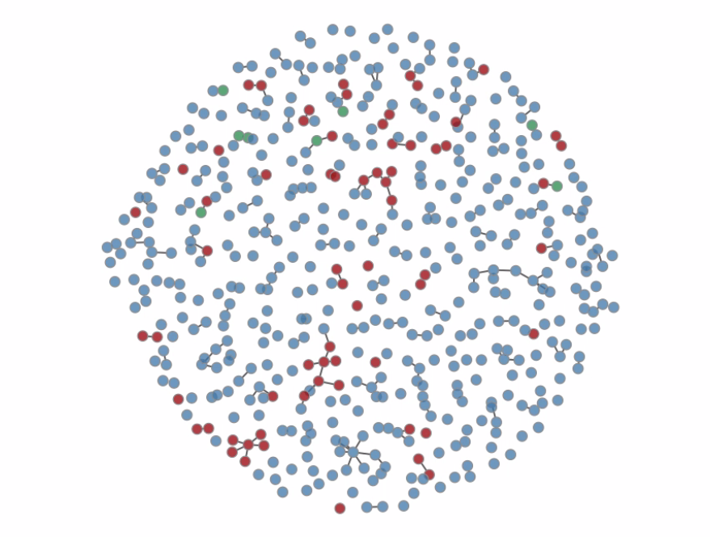
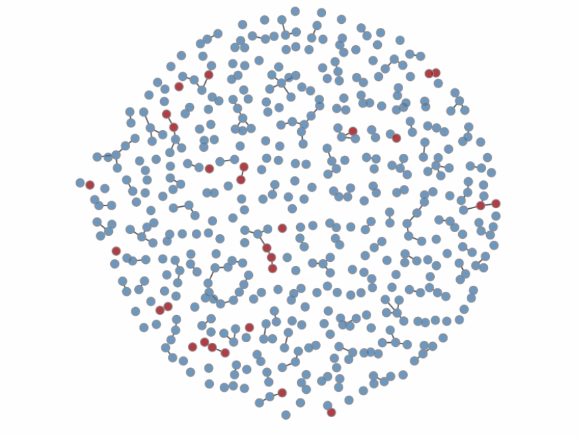
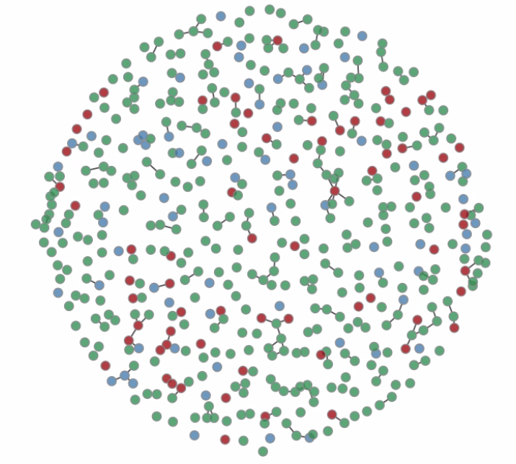
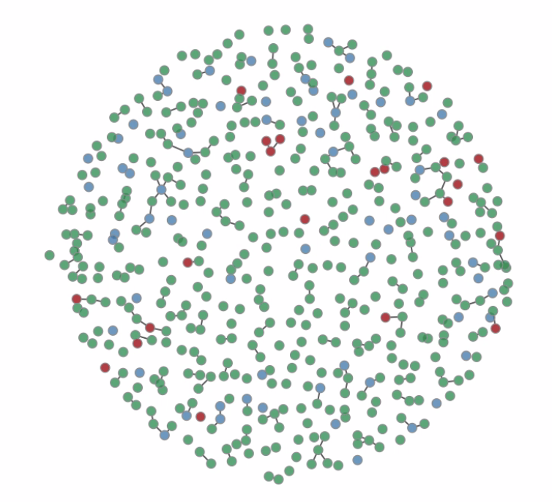
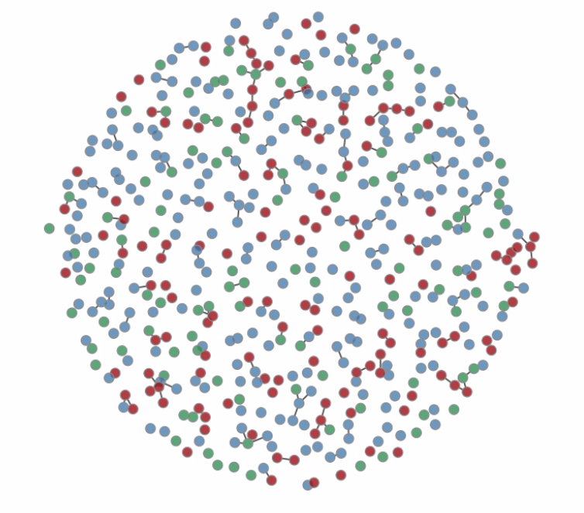
Spreading the virus..

Slide 21
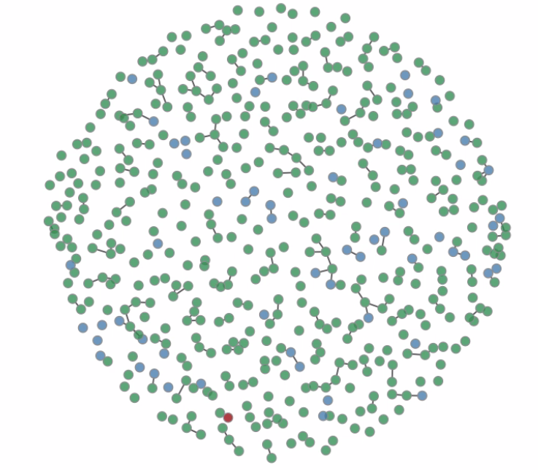
..and finally

Slide 22
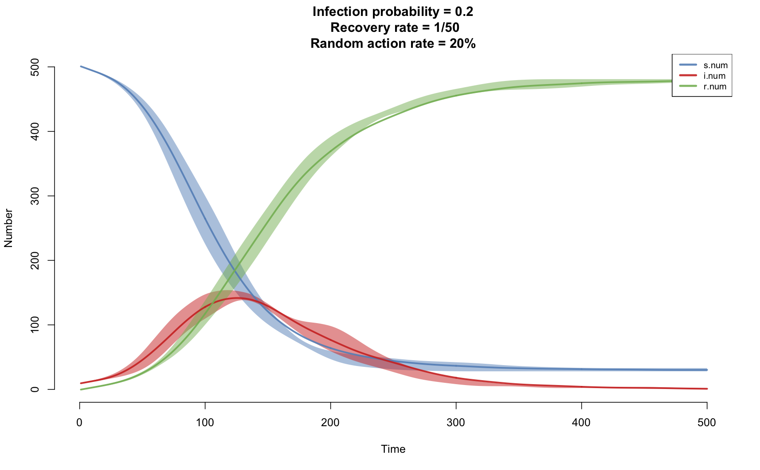
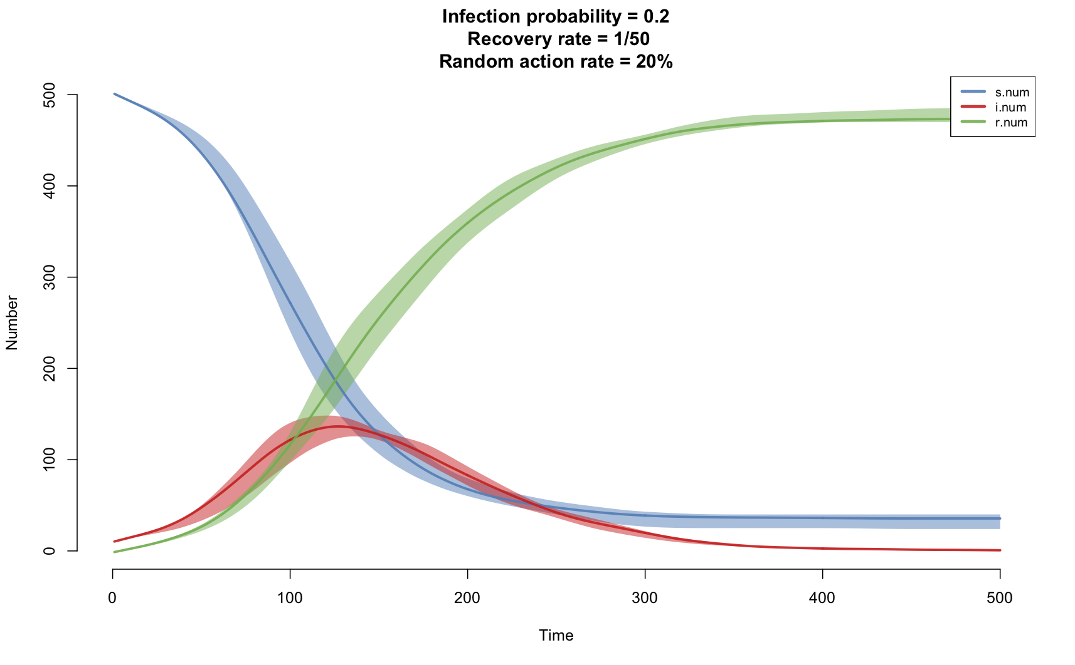
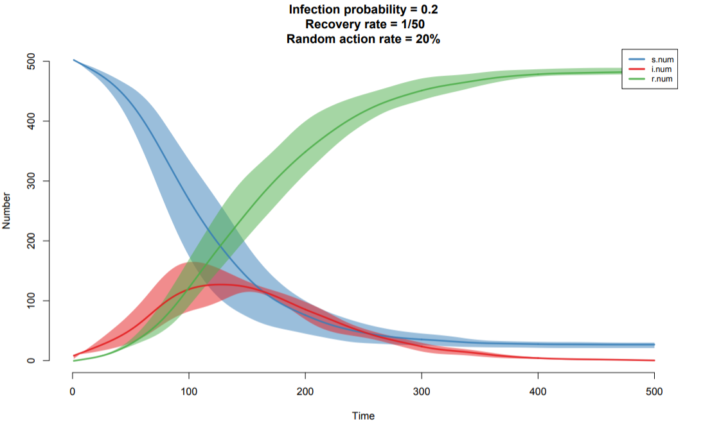
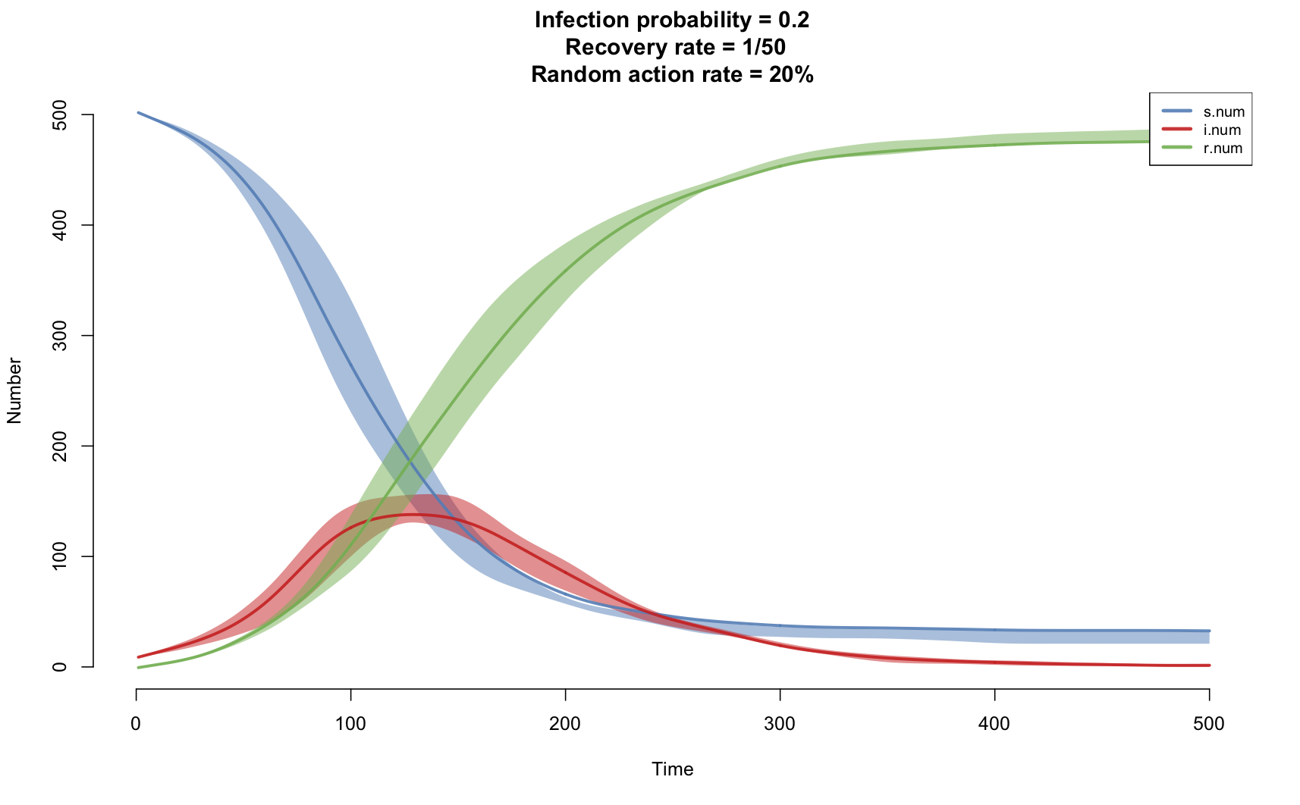
Infection probability = 0.2
Notes:
We used a library called EpiModel to model this graph.
We considered a timestep of 1 and and simulated 500 times?
shaded because the lines gonna be different for the different random numbers we generate.
The line in the middle of the shaded region is the plot for the deterministic model, without considering any random numbers.

Slide 23


Slide 24

A different view
A simulation modeling tool that can develop models using discrete event, agent based, and system dynamics methodologies
Notes:
Introduce the software
(add params in diff slide)

Slide 25
Things we considered
Network for modelling:
Random
Distance-based
Fixed Parameters:
Total population (500)
Fraction initially infected (2%)
Average illness duration (5 days)
Links per agent (5)

Slide 26
Things we considered
Parameters to vary:
Contact rate
Infectivity
This variation is not SIMULTANEOUS! So when we are changing contact rate, we are keeping infectivity fixed and vice versa.

Slide 27
Random Network Based Model
Contact rate | Infectivity
3 | 0.2
5 | 0.2
10 | 0.2
Notes:
Slide for table1

Slide 28

Notes:
Video

Slide 29
Notes:
anothe r video

Slide 30
Simulation Results
(Random network based model)

Slide 31
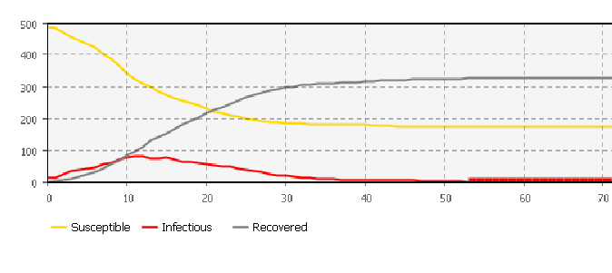
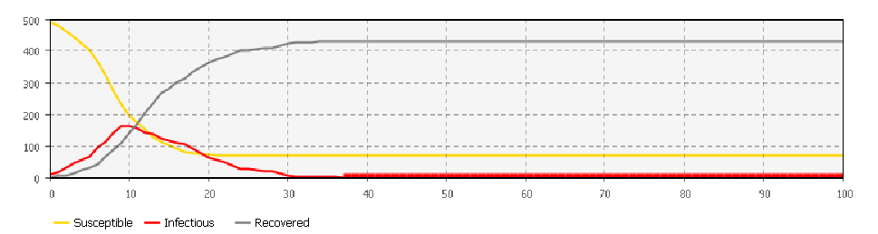
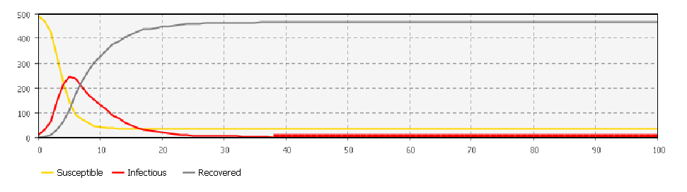
Contact rate = 3/day
Contact rate = 5/day
Contact rate = 10/day

Slide 32
Random Network Based Model - Result
Contact rate | Infectivity | Max number of infected pop on a certain day | T at which I=0
3 | 0.2 | 80 (D=12) | 36
5 | 0.2 | 160 (D=8) | 31
10 | 0.2 | 240 (D=5) | 25
Notes:
Slide for table1

Slide 33
Random Network Based Model
Contact rate | Infectivity
5 | 0.2
5 | 0.4
5 | 0.6
Notes:
Slide for table2

Slide 34
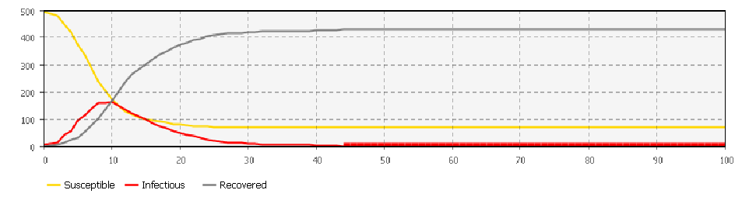
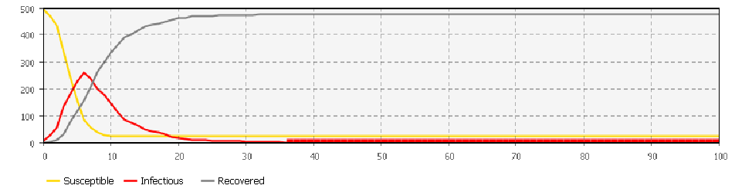
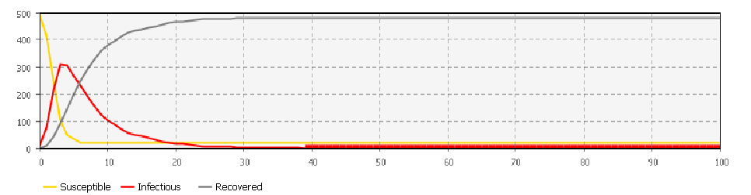
Infectivity = 0.2
Infectivity = 0.4
Infectivity = 0.6

Slide 35
Random Network Based Model
Contact rate | Infectivity | Max number of infected pop on a certain | T at which I=0
5 | 0.2 | 160 (D=10) | 32
5 | 0.4 | 260 (D=6) | 25
5 | 0.6 | 310 (D=3) | 24
Notes:
Slide for table2

Slide 36
Simulation Results
(Distance based model)

Slide 37
Distance based model
Contact rate | Infectivity
3 | 0.2
5 | 0.2
10 | 0.2
Notes:
Slide for table1
distance

Slide 38
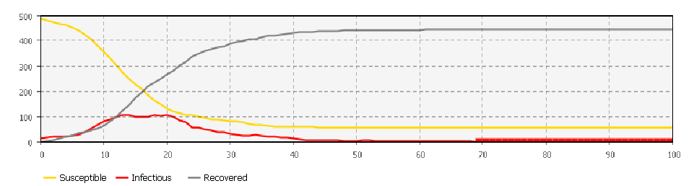
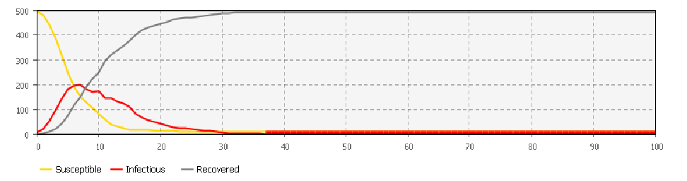
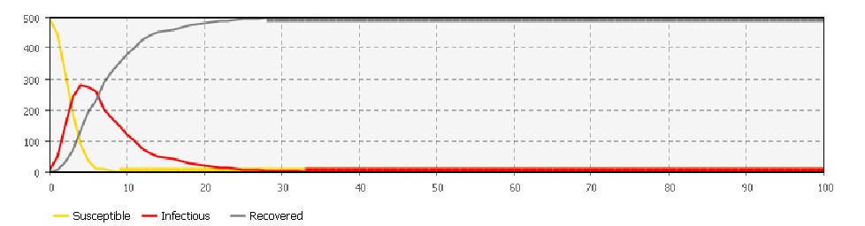
Contact rate = 3/day
Contact rate = 5/day
Contact rate =10/day

Slide 39
Distance based model - Result
Contact rate | Infectivity | Max number of infected pop on a certain day | T at which I=0
3 | 0.2 | 105 (D=14,20) | 43
5 | 0.2 | 200 (D=7) | 31
10 | 0.2 | 280 (D=4) | 25
Notes:
Slide for table1
distance

Slide 40
Distance based model
Contact rate | Infectivity
5 | 0.2
5 | 0.4
5 | 0.6
Notes:
Slide for table2 distace

Slide 41
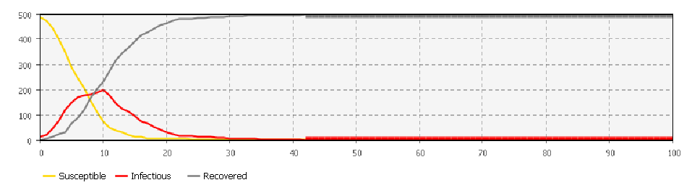
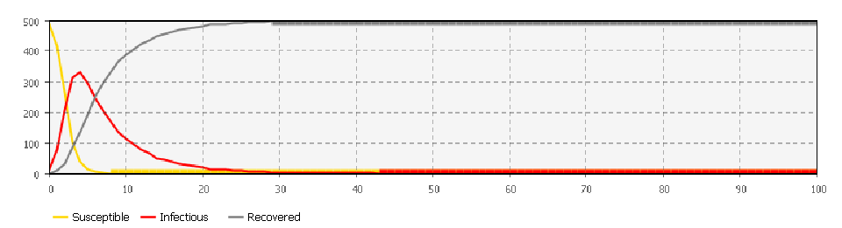
Infectivity = 0.2
Infectivity = 0.4
Infectivity = 0.6

Slide 42
Distance based model - Result
Contact rate | Infectivity | Max number of infected pop | T at which I=0
5 | 0.2 | 200 (D=10) | 30
5 | 0.4 | 330 (D=4) | 26
5 | 0.6 | 340 (D=3) | 20
Notes:
Slide for table2 distace

Slide 43
Conclusion
For both model, with increasing contact rate/day i)Total number of infectious population increases. ii) Maximum number of infectious population is reached earlier or faster iii) Total number of recovered people increases and susceptible decreases before going to stability.
For both model, with increasing infectivity i)Total number of infectious population increases. ii) Maximum number of infectious population is reached earlier or faster iii) Total number of recovered people increases and susceptible decreases before going to stability.
For our simulation, (where we used distance unit=50) more people were infected and eventually recovered in distanced based model than random one. This might NOT be the case when we change the distance unit.

Slide 44
Future Work
Consider more different kinds of network model, like ring lattice, scale free, small world etc.
Infection probability according to gender, race, occupations etc
Infection probability in a particular place while traveling
Change multiple parameters at a time to see how it affect the system
Notes:
Consider more stuff from EpiFlex software.
Should we name the software
HOW DO WE WRITE FUTURE WORK!!!
Include stuff from Calibration of Agent Based SIR.

Slide 45
References
http://www.sinobiological.com/1968-Influenza-Pandemic-Hong-Kong-Flu-a-5754.html
An object simulation model for modeling hypothetical disease epidemics - Brian Hanley - Theoritical Biology and Medical Modeling (2006)
Modeling Influenza epidemics and pandemics - Brian Coburn, Bradley Wagner, Sally Blower
Stochastic Epidemic modeling - Priscilla Greenwood, Luise Gordillo - AI Math Workshop

Slide 46

Questions?

